Slide 1
Analisis Data COVID19 di Dunia & ASEAN

Slide 2
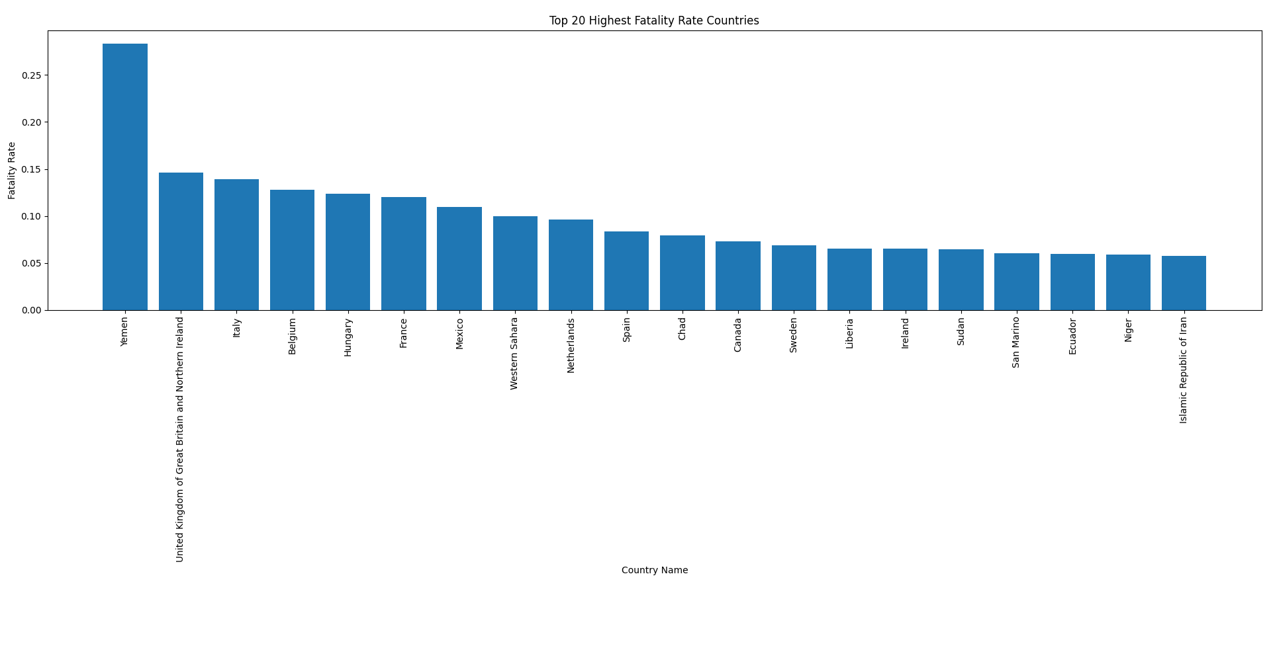
TOP 20 Highest Fatality Rate Countries

Slide 3
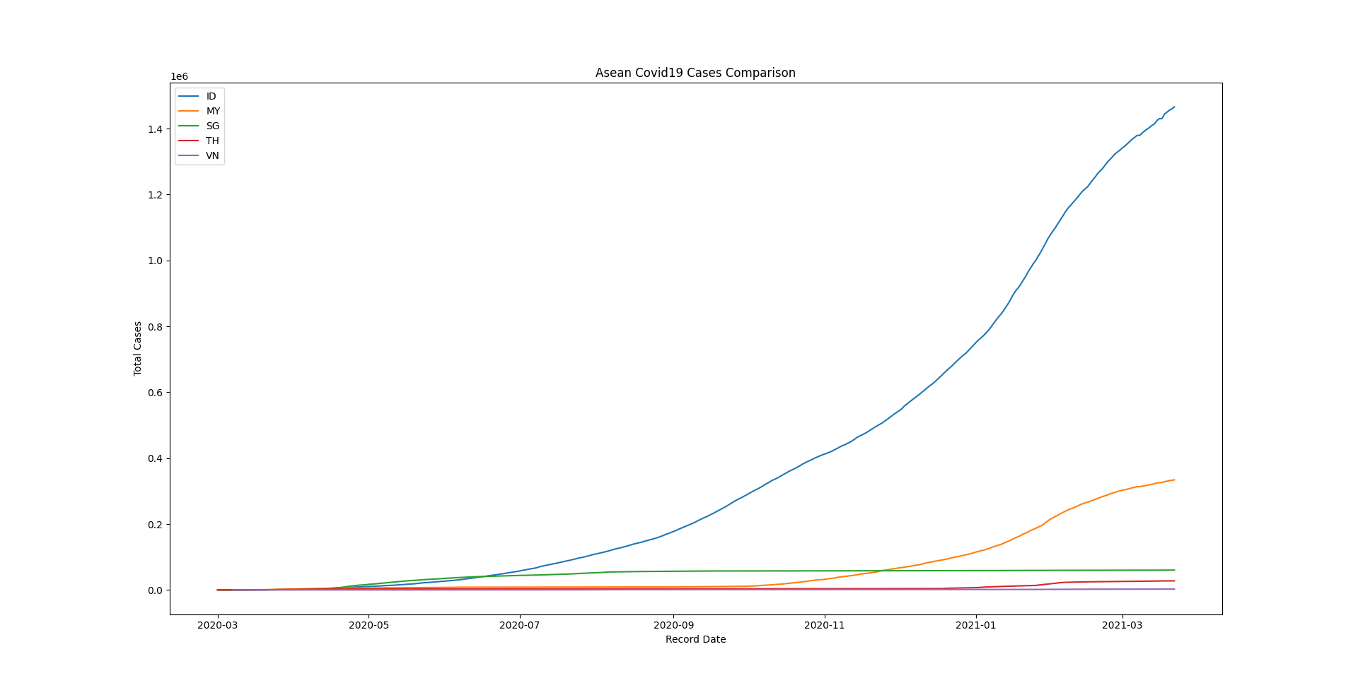
ASEAN Covid 19 Cases Comparation

Slide 4
Terima Kasih

